Slide 1
UArctic
uarctic.org

Slide 2
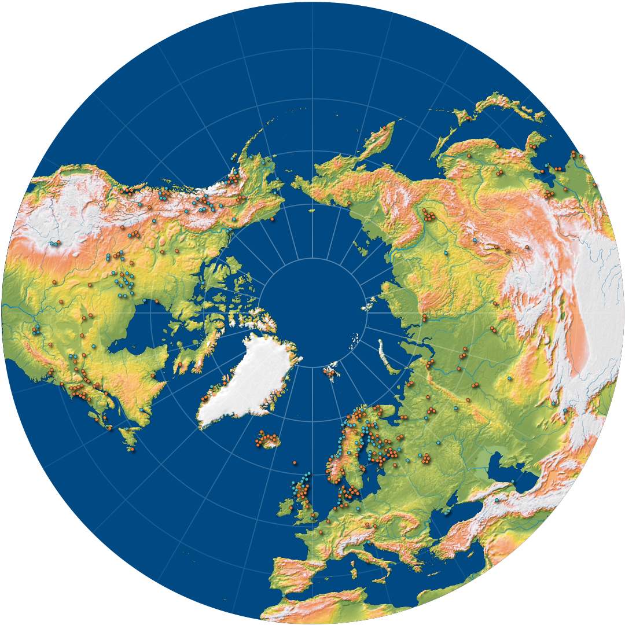
Who We Are
The University of the Arctic (UArctic) is a network of universities, colleges, research institutes, and other organizations concerned with education and research in and about the North. UArctic builds and strengthens collective resources and infrastructures that enable member institutions to better serve their constituents and their regions. Through cooperation in education, research, and outreach we enhance human capacity in the North, promote viable communities and sustainable economies, and forge global partnerships.
Created through the Arctic Council, UArctic is committed to upholding its principles of sustainable development as well as the United Nations Sustainable Development Goals. UArctic is constituted as an international association based in Finland.

Slide 3
Why the Arctic matters
The Arctic is where we see the strongest impacts of the climate change today. While the Arctic has just a fraction of a percent of the world’s population, it contributes nearly 20% of many globally important resources such as minerals, energy, fish, freshwater, and the most pristine nature, which illustrates its interdependence with the rest of the globe. The Arctic is a vital region for the world, and UArctic has a key role in ensuring that those outside the region understand northern realities.

Slide 4
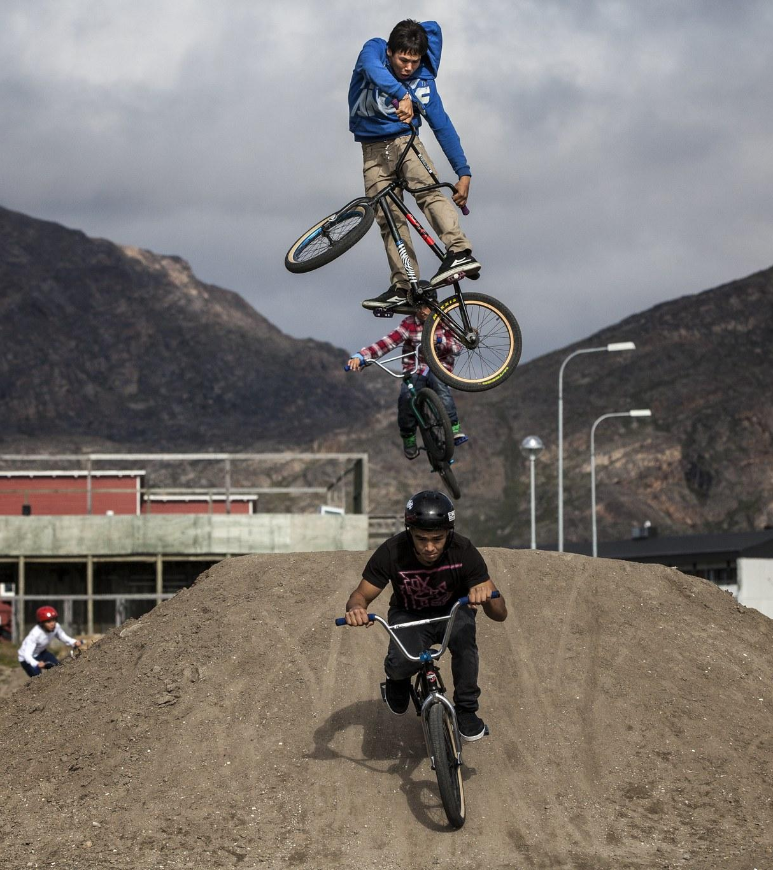
Vision
A strong, engaged, informed, and dynamic North, creating better lives and environments for all northerners.

Slide 5
Values
Circumpolar
UArctic promotes northern voices and a circumpolar world view.
Inclusive
UArctic embraces and respects cultural diversity, language plurality, and gender equality.
Respectful
UArctic promotes relationships of respect, trust, and partnership, and embraces the perspectives and knowledge of northern Indigenous peoples.
Collaborative
Arctic is committed to supporting participatory approaches to the production and sharing of knowledge.
Open
UArctic is a university network without walls, committed to reducing all barriers to cooperation across borders, cultures, and academic systems, embracing transparency and openness.
Influential
UArctic provides decision-makers with knowledge-based advice that supports sustainable development in the Arctic.

Slide 6
UArctic develops knowledge to address local and global challenges of relevance to Arctic peoples and societies by providing unique educational, research, and innovation opportunities through collaboration within a powerful network of member institutions.
Mission

Slide 7
“With Shared Voices”
MOTTO

Slide 8
To reach our Vision of “A strong, engaged, informed and dynamic North, creating better lives and environments for all northerners,” it is important that northerners themselves have the keys to determine their own futures and implement the UN Sustainable Development Goals in a way that serves both the North and the world.
Impact

Slide 9
Goals
Education
UArctic enhances and promotes unique and relevant educational opportunities for northerners through academic collaboration and exchange.
Knowledge
UArctic builds, shares, and applies knowledge through member contributions and collaboration, in research and science as well as Indigenous and traditional knowledge.
Members
UArctic aims at a growing and dynamic membership of higher education institutions and other relevant organizations.
Resources
UArctic secures funding and other resources to effectively strengthen capacity and capabilities for the Arctic. To reach these goals, UArctic is guided by our Values and Motto.
Relevance
UArctic strengthens our recognition as a regionally and globally leading organization representing circumpolar higher education.

Slide 10
How UArctic Operates
1.
UArctic activities are carried out by the collaborative work of our members.
UArctic fosters flexible and innovative frameworks that support cooperation between members, furthering our goals.
UArctic is a learning organization that brings together the shared knowledge, diversity, and experience of our membership.
UArctic is a driver of internationalization and partnerships for higher education and research.
UArctic recognizes our specific commitment towards northern Indigenous peoples, and respect for their cultures, languages, traditional knowledge, and world views.
6.
UArctic brings the voices and knowledge of our members to the global stage.
UArctic supports knowledge-based decision-making at all levels, including key regional partners such as the Arctic Council, and the private sector.
UArctic secures funding, maintains an efficient and distributed administration, and reports reliably on our activities.
UArctic operates through trusted partnerships with other regional and global actors.
UArctic is committed to minimizing the environmental impact of our operations while finding innovative ways to bring northerners together.
2.
7.
3.
8.
4.
9.
5.
10.

Slide 11
Thank you!
Want to know more?
uarctic.org

Slide 12
Template & Materials
(Without slide animations)

Slide 13
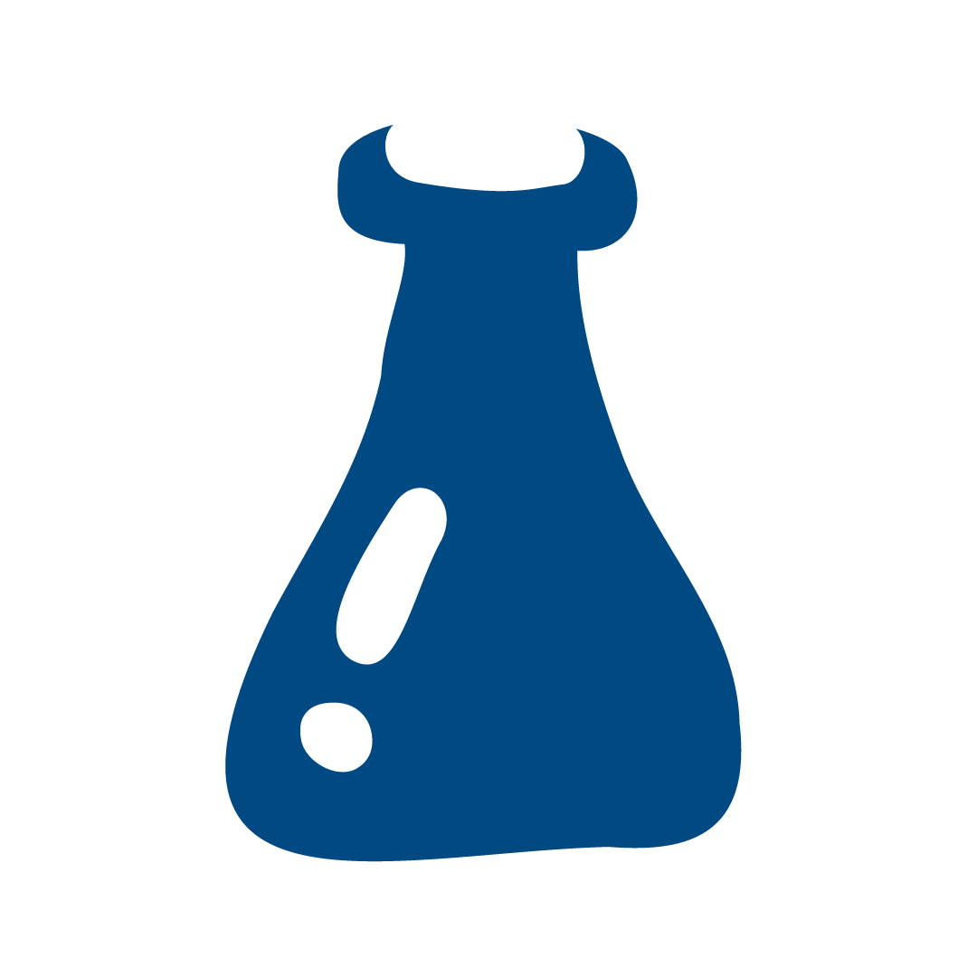
Graduate
Outreach
North2North
Goals
Relevance
Publications
Events
Mobility
Institutions
Impact
Research
Exhibitions
Project grants
Members
Values
PHD courses
Vision
Motto
Mission
Discussion

Slide 14
UArctic
uarctic.org

Slide 15
UArctic
uarctic.org

Slide 16
UArctic
uarctic.org

Slide 17
UArctic
uarctic.org

Slide 18
UArctic
uarctic.org

Slide 19
